Slide 1

Barrett Honors Thesis
iLieDown: Improved Display Orientation for Handheld Devices Using Convolutional Neural Networks
Riley Tallman
rtallman@asu.edu
Professor Yezhou Yang
yz.yang@asu.edu
Zhiyuan Fang
zfang29@asu.edu

Slide 2
Part I: The Problem

Slide 3
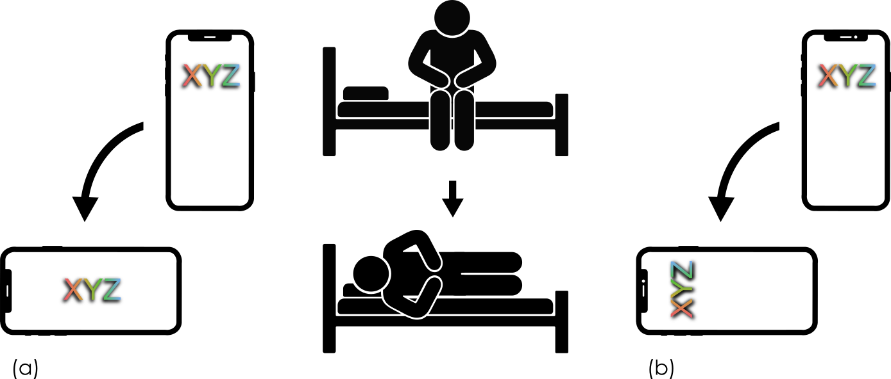
The Problem
Correct vs Incorrect Rotation. The user lies down and the screen rotates incorrectly in (a), but correctly in (b).

Slide 4
91% of users experience incorrect autorotation [1].

Slide 5
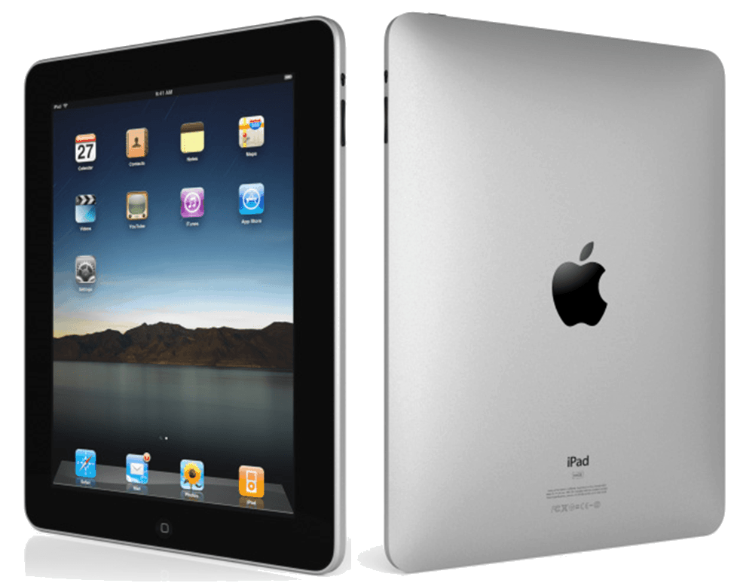
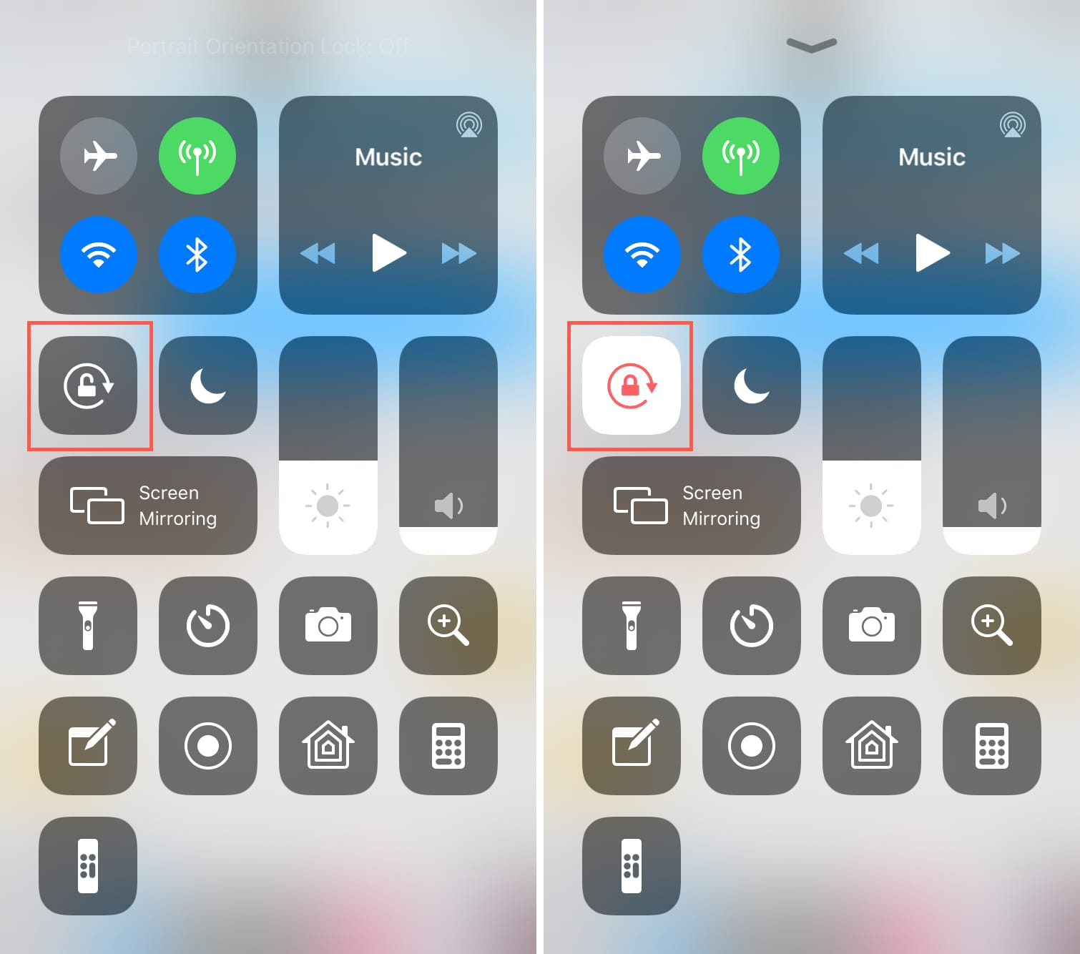
Current Solution
Manual Orientation Lock
Physical switch
Software switch

Slide 6
27% of users are unaware of rotation lock [1].

Slide 7
Part II: Our Solution

Slide 8
iLieDown
The user’s face will always show the correct orientation
Capture images
Analyze
Orient
Repeat 30 times per second?

Slide 9


iLieDown
CPU utilization during CNN* analysis at 30FPS
20%
iPhone 6
7%
iPhone XS
*CNN with 23,090 parameters

Slide 10
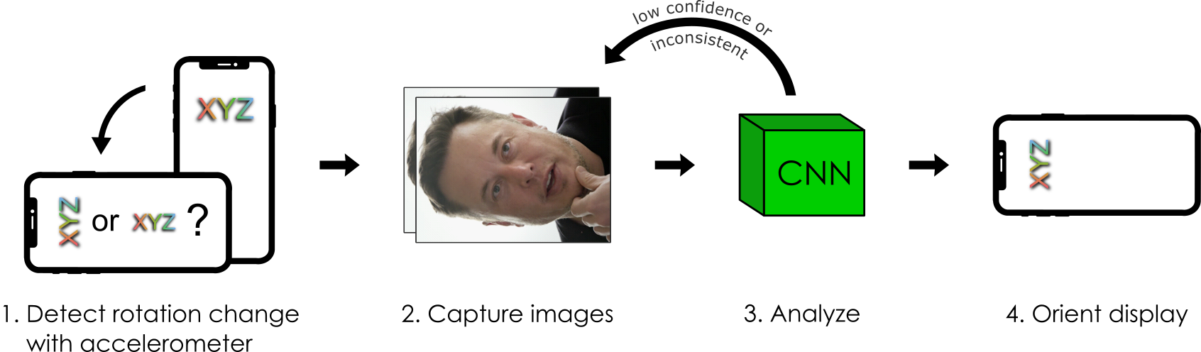
iLieDown
Efficient solution

Slide 11
Part III: Experiments

Slide 12
Feasibility Test
Does it work?
20 users were tested in different environments and lighting conditions with an iPhone 6
Users were unaware of the application and given a reading task to simulate real-world device use
61% Success Rate
6x improvement over previous solution [1]

Slide 13
Privacy Survey
Camera access required
If iLieDown was a feature integrated into the OS, it would take pictures every time the device was rotated.
100% Would use it
2 users said only if the company was reputable
10 users were okay with anonymous collection of images
Notes:
some companies have a history of negligence and/or intentional misuse of users’ data.

Slide 14
Noticeable Lag Test
Camera access required
Users were given native orientation and iLieDown and asked to determine if one was faster than the other
70% Reported Same Speed
iPhone 6
iPhone XS

Slide 15
Thank you
https://rptallman.github.io/portfolio/

